Slide 1

GOOGLE APP STORE DATA ANALYSIS
SUBMITTED BY:
T.DATTATREYA
NIT JAIPUR

Slide 2
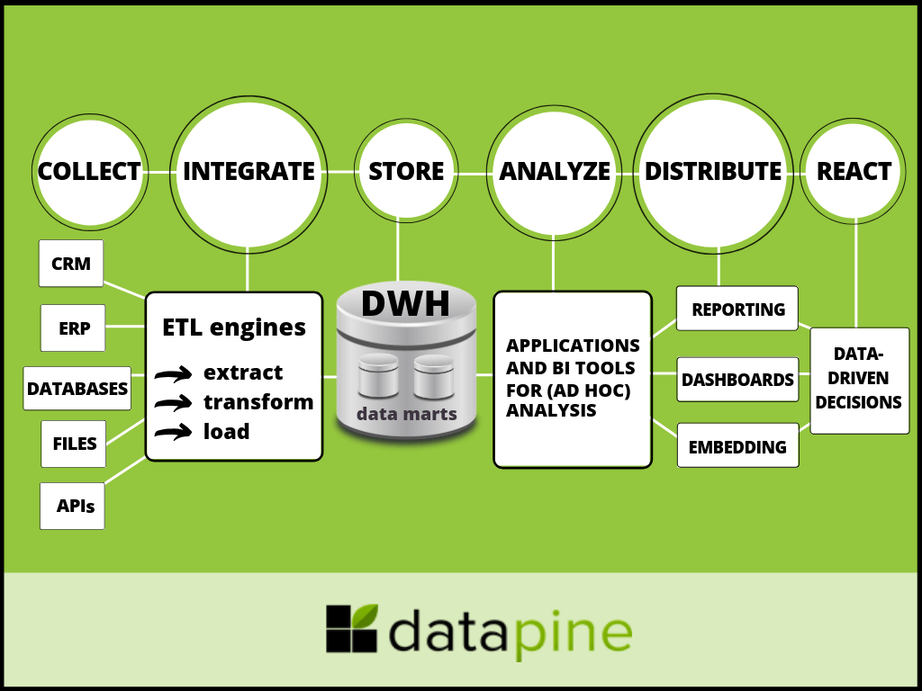
ARCHITECTURE

Slide 3
ETL OPERATIONS
Data is collected from the given dataset.
Imported the data to Power BI Desktop
Transformed the Data by renaming certain Columns and removing the Null Values and Errors in the Data Set
Changed the Data type according to the Column
Saving the changes done in Power BI Query Editor and closing the Transformation page

Slide 4
PAGES IN THE REPORT PUBLISHED
Table Overview
Insights
Top 10 Category
Treemap
Dashboard

Slide 5
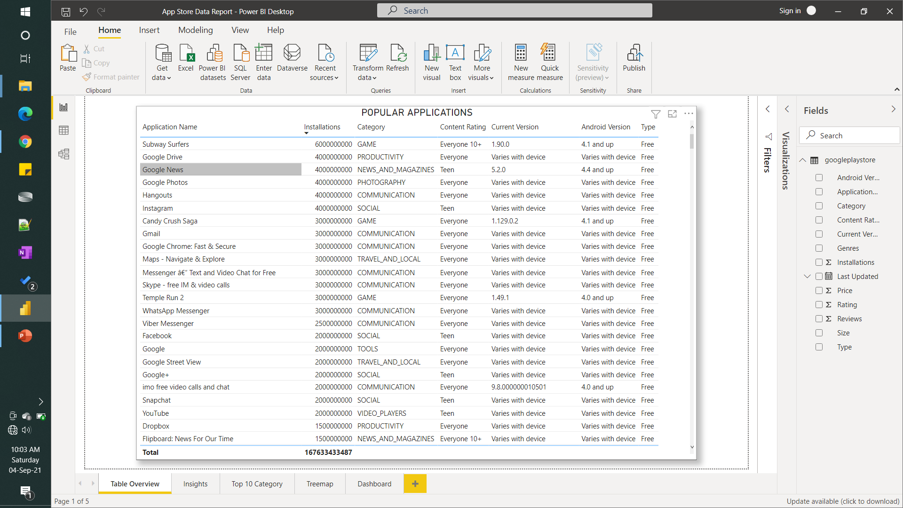
TABLE OVERVIEW
The top apps by number of downloads are:
Subway Surfers
Google Drive
Google News
Google Photos
Hangouts
Instagram
Candy Crush Saga

Slide 6
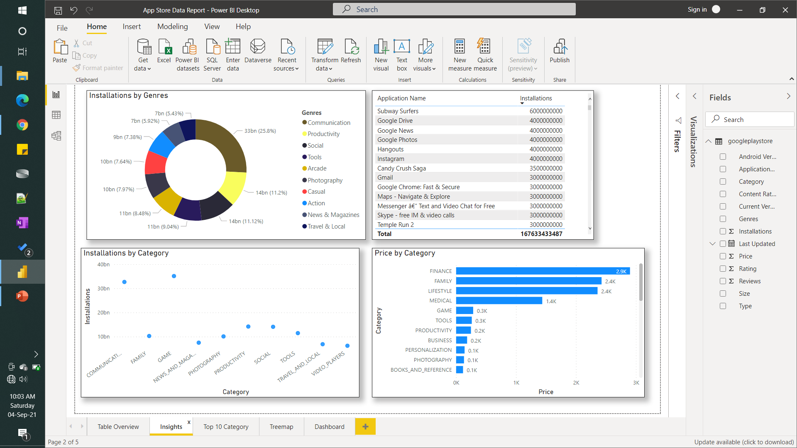
INSIGHTS
The top Genres by number of downloads are:
Communication
Productivity
Social
Tools have more than 50% share by category
Paid apps are more frequent and common in the category of
Finance
Family
Lifestyle
Medical
Gaming

Slide 7
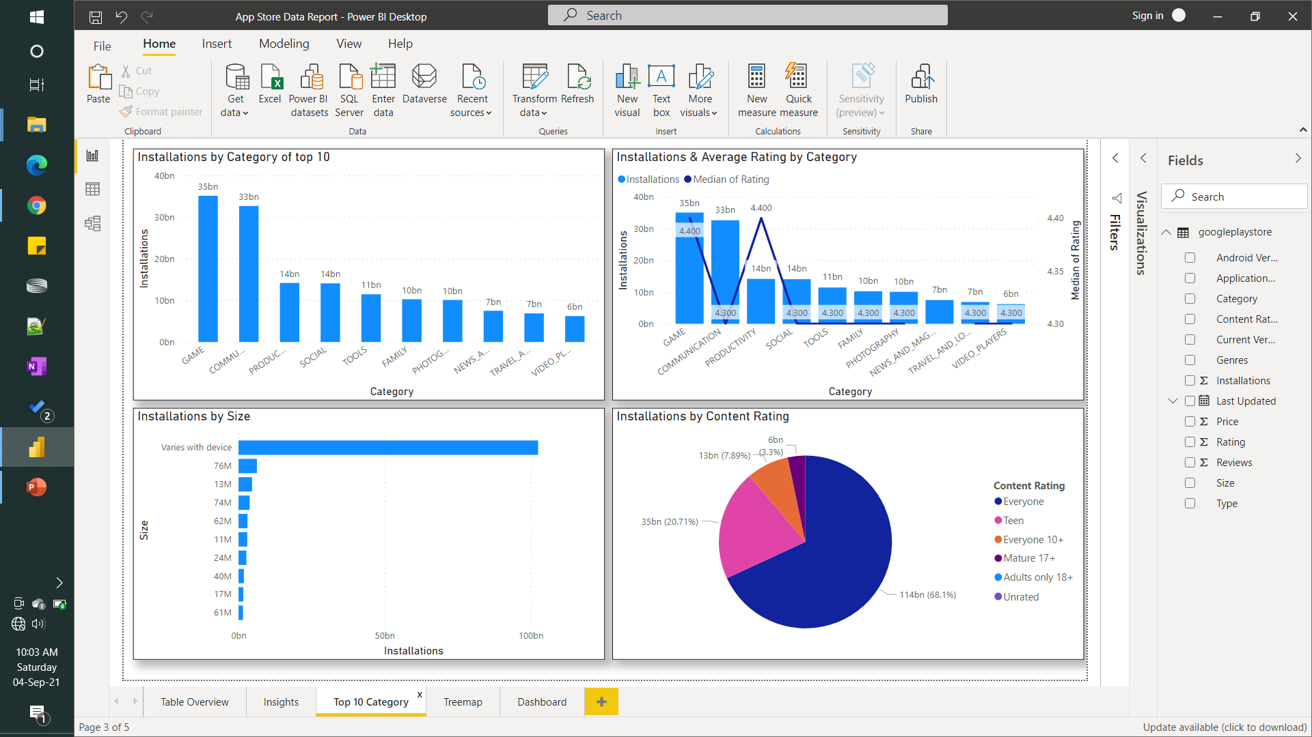
TOP 10 CATEGORY
From this page we get to know about the top 10 Categories by installations with their Average ratings and Content rating with application size

Slide 8
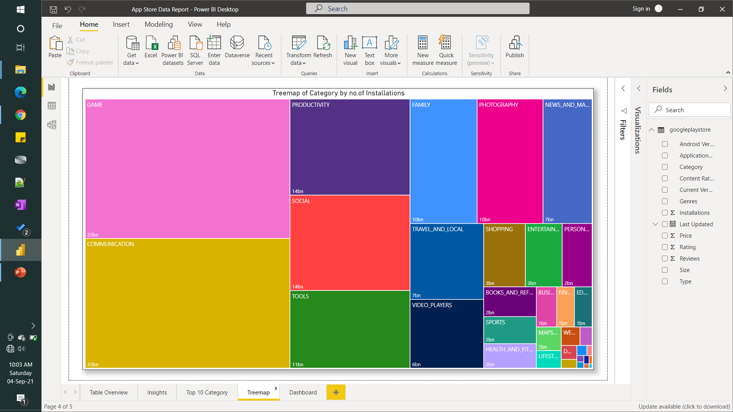
TREEMAP
This Treemap depicts the category with respect to number of installations done.

Slide 9
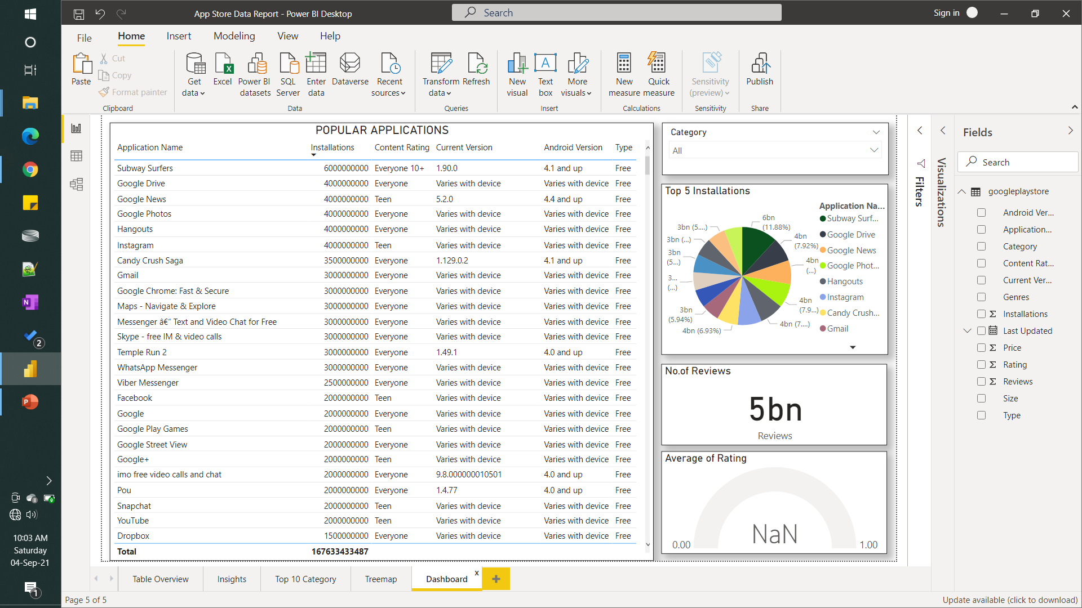
DASHBOARD
This is a dashboard by which we get an high-level overview of the apps & can select and know about the
Category
Top Installations
Total no. of reviews
Average rating of the app

Slide 10













TOP APPS BY CATEGORY
Top apps in Art & Design are: Sketch – Draw & Paint, Textgram, Canva.
Top apps in Automobile are: Android Auto, AutoScout24, Fines of State traffic Safety.
Top apps in Beauty are: Beauty Camera – Selfie Camera, Best Hairstyle step by step.
Top apps in Books are: Google Play Books, Amazon Kindle, Audiobooks by Audible, Bible.
Top apps in Business are: Office Suite: Free office + PDF Editor, File Commander, Free office Suite.
Top apps in Comics are: Line Webtoon – Free comics, Comics, Narrators voice.
Top apps in Communication are: Hangouts, Gmail, Google Chrome, WhatsApp, Skype, Messenger.
Top apps in Education are: Duolingo, Google Classroom, TED, Khan Academy.
Top apps in Entertainment are: Google Play Games, Netflix, IMDB Movies , Hotstar, Amazon Prime.

Slide 11
Q & A
What's the Source of the Data - Collected from Given Data Set
What was the type of Data - Numerical and Categorical Values
What is the flow of the project - According to the Architecture mentioned above
How did you deploy the report - With the help of Power BI Service available to my Microsoft Account
What results did you get - You can see the Top 10 Category slide above or download the file and slice the category you need & get the desired result

